Slide 1
Neural Nets

Slide 2
Input Layer :- This layer accepts input features. It provides information from the outside world to the network, no computation is performed at this layer, nodes here just pass on the information(features) to the hidden layer.
Hidden Layer :- Nodes of this layer are not exposed to the outer world, they are the part of the abstraction provided by any neural network.
Hidden layer performs all sort of computation on the features entered through the input layer and transfer the result to the output layer
Output Layer :- This layer bring up the information learned by the network to the outer world.

Slide 3
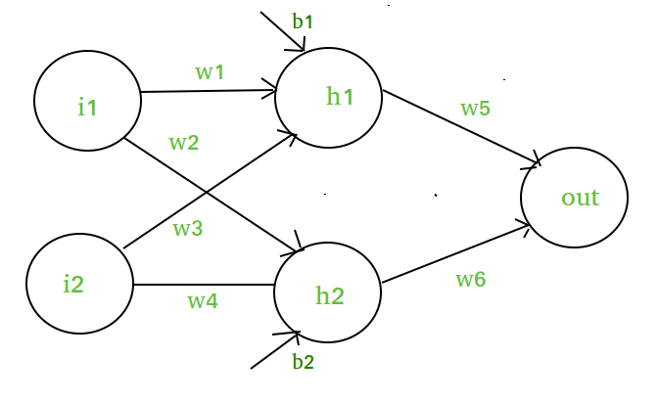

Slide 4
Activation function
Decides whether a neuron should be activated or not by calculating weighted sum and further adding bias with it.
The purpose of the activation function is to introduce non-linearity into the output of a neuron.

Slide 5
Types OF ACTIVATION FUNCTION
1). Linear Function :-
Equation : Linear function has the equation similar to as of a straight line i.e. y = ax
Range : -inf to +inf
Uses : Linear activation function is used at just one place i.e. output layer.

Slide 6
2). Sigmoid Function :-
A = 1/(1 + e^{-x})
Nature : Non-linear
Small changes in x would also bring about large changes in the value of Y.
Value Range : 0 to 1
Uses : Usually used in output layer of a binary classification, where result is either 0 or 1, as value for sigmoid function lies between 0 and 1 only so, result can be predicted easily to be 1 if value is greater than 0.5 and 0 otherwise.

Slide 7
3. Tanh Function: Tangent Hyperbolic function.
tanh(x) = 2/(1 + e^{-2x}) – 1
OR tanh(x) = 2 * sigmoid(2x) - 1
Value Range :- -1 to +1
Nature :- non-linear
Uses :- Usually used in hidden layers of a neural network as it’s values lies between -1 to 1 hence the mean for the hidden layer comes out be 0 or very close to it, hence helps in centering the data by bringing mean close to 0. This makes learning for the next layer much easier.

Slide 8
4) RELU :- Rectified linear unit
Implemented in hidden layers of Neural network.
A(x) = max(0,x).
It gives an output x, if x is positive and 0 otherwise.
Value Range :- [0, inf)
Nature :- non-linear, which means we can easily backpropagate the errors and have multiple layers of neurons being activated by the ReLU function.
Uses :- ReLu is less computationally expensive than tanh and sigmoid because it involves simpler mathematical operations. At a time only a few neurons are activated making the network sparse making it efficient and easy for computation.

Slide 9
Softmax Function :- The softmax function is also a type of sigmoid function but is handy when we are trying to handle classification problems.
Nature :- non-linear
Uses :- Usually used when trying to handle multiple classes. The softmax function would squeeze the outputs for each class between 0 and 1 and would also divide by the sum of the outputs.
Output:- The softmax function is ideally used in the output layer of the classifier where we are actually trying to attain the probabilities to define the class of each input.

